Slide 1
“ WE DON’T SEE THINGS AS THEY ARE,
WE SEE THINGS AS WE ARE.”

Slide 2
Perception
“ The study of perception is concerned with identifying the process
through which we interpret and organize sensory information to
produce our conscious experience of objects and object relationship.”
“ Perception is the process of receiving information about and making sense of the world around us. It involves deciding which information to notice, how to categorize this information and how to interpret it within the framework of existing knowledge.
“ A process by which individuals organize and interpret their sensory impressions in order to give meaning to their environment.
<number>

Slide 3
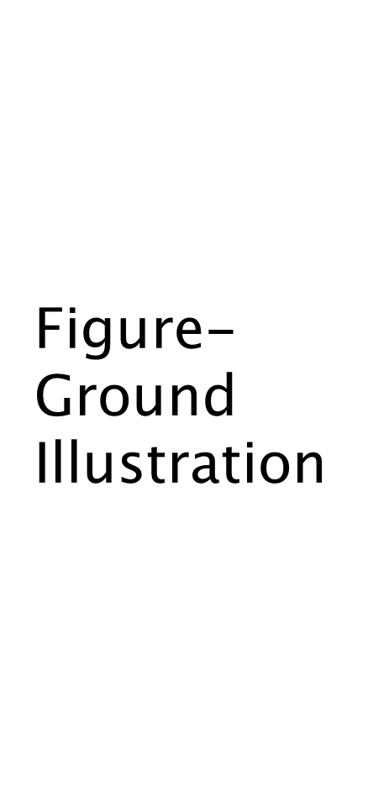
Field-ground differentiation
The tendency to distinguish and focus on a stimulus that is classified as figure as opposed to background.
<number>

Slide 4
PERCEPTUAL GROUPING
Our tendency to group several individual stimuli into a meaningful and recognizable pattern.
It is very basic in nature and largely it seems to be inborn.
Some factors underlying grouping are
-continuity
-closure
-proximity
-similarity
<number>

Slide 5
Person Perception: Making Judgments About Others
<number>

Slide 6

Selective Perception :
People selectively interpret what they see on the basis of their interests, background, experience and attitudes.
Halo Effect :
Drawing a general impressions about an individual on the basis of a single charecteristics.
Organizational Behavior / Perception
<number>

Slide 7
Contrast Effect :
Evaluation of a person’s characteristics that are effected by comparisons with other people recently encountered who rank higher or lower on the same characteristics.
Projection :
Attributing one's own characteristics to other people.
Stereotyping :
Judging someone on the basis of one’s perception of the group to which that persons belongs.
Organizational Behavior / Perception
<number>
Notes:
<number>

Slide 8

Organizational Behavior / Perception
<number>

Slide 9
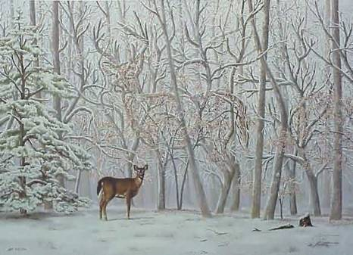
<number>

Slide 10
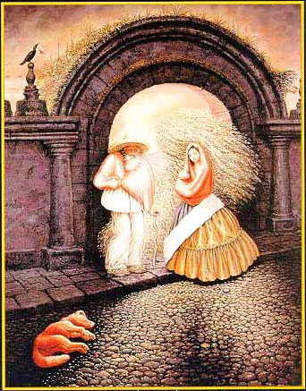
Organizational Behavior / Perception
<number>

Slide 11

Organizational Behavior / Perception
<number>

Slide 12
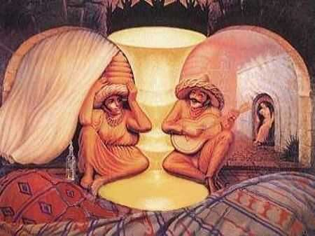
Organizational Behavior / Perception
<number>

Slide 13
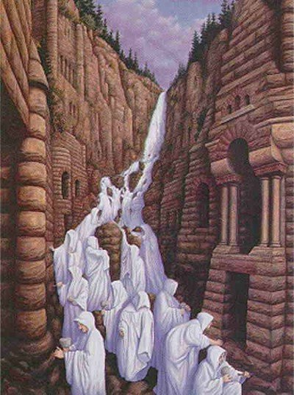
Organizational Behavior / Perception
<number>

Slide 14
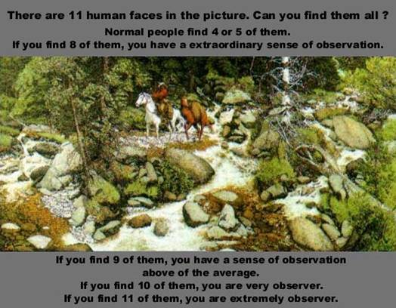
Organizational Behavior / Perception
<number>

Slide 15
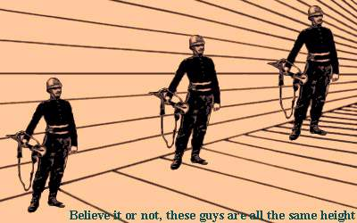
Organizational Behavior / Perception
<number>

